Slide 1


Networks-1 Project
The Distributed
E-Commerce Fulfillment Network
Project 5

Slide 2
Team Members
Ahmed Mohamed 20240074
Marwan Ahmed 20240918
Eyad ahmed 20240175
Lujain Sherif 20240740
nourhan saeed 20241076
hoda abd-elnasser 20241098
sarah mohamed 20240406
doaa amer 20240335

Slide 3


ABOUT PROJECT
Simulate a company where four routers connect the Corporate HQ, Data Center, Fulfillment Center (80 hosts), and Shipping Hub (14 hosts). VLSM is used to assign addresses starting from a private 172.16.0.0 block. The Data Center hosts the public-facing Web Server and DNS Server. To sync inventory data, a VPN is established between the Fulfillment Center and the Data Center using Static Routing through the 4-router path. The edge routers must implement Static NAT for the storefront. All troubleshooting must be documented using ICMP "extended pings" to ensure the VPN remains stable across the multiple hops.

Slide 4

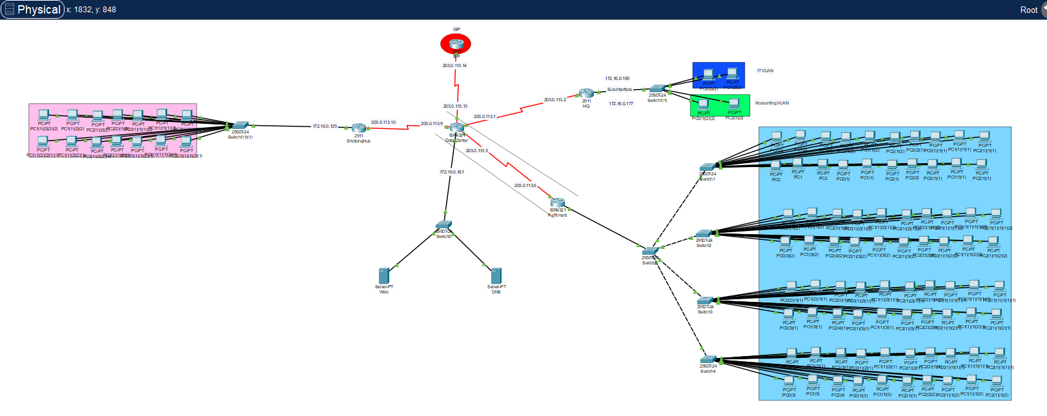
topology

Slide 5
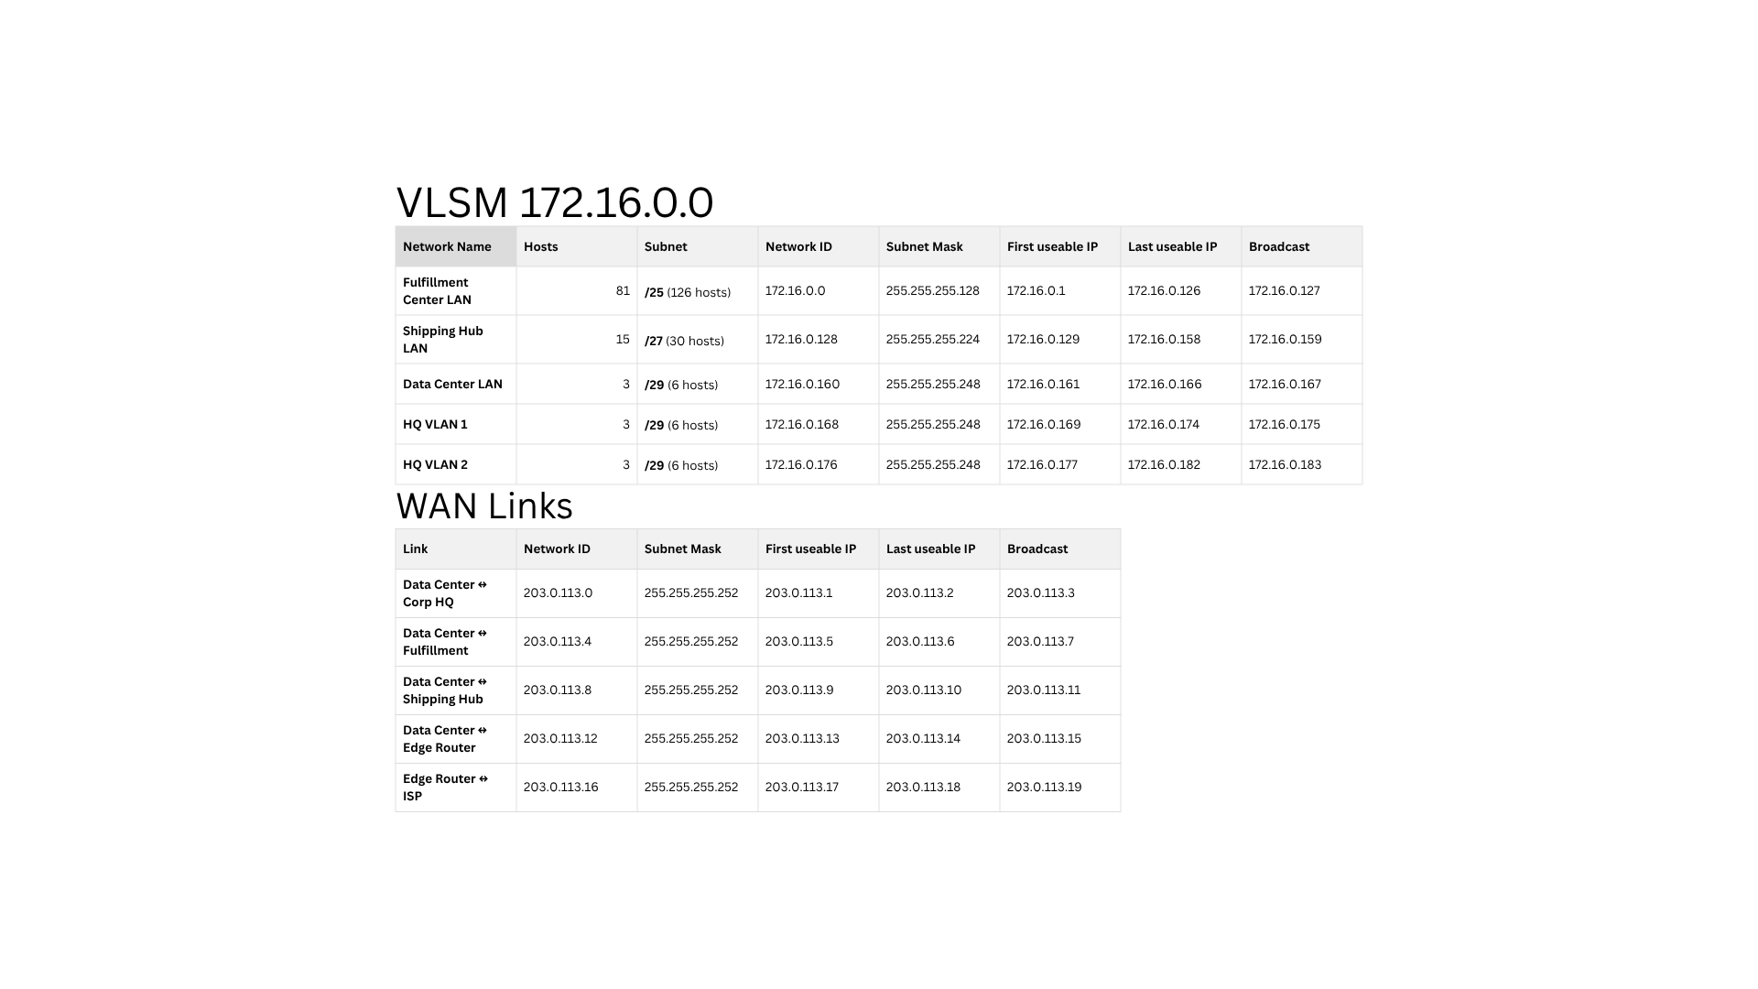
VLSM PRIVATE
VLSM WAN Links

Slide 6
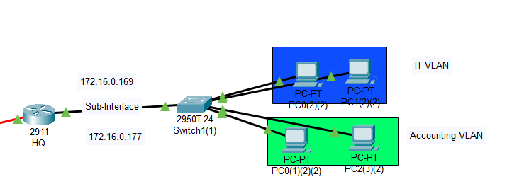
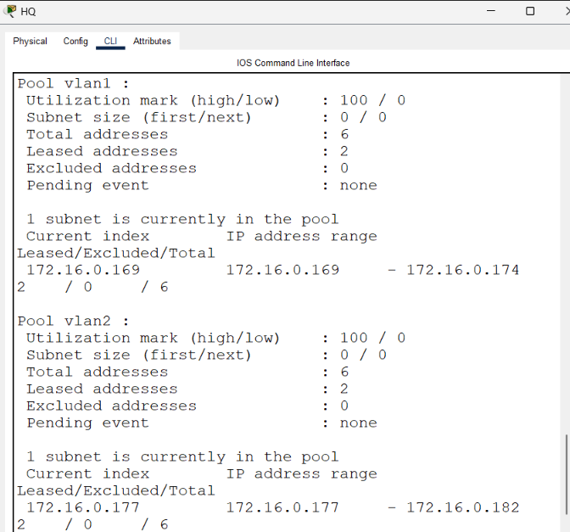
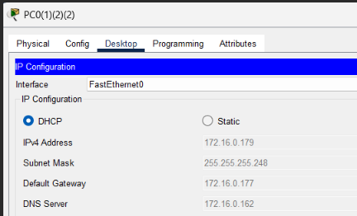
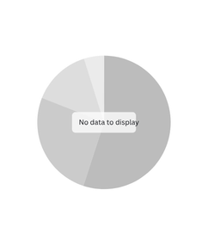
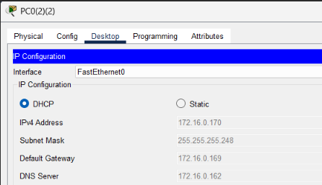
HQ : DHCP

Slide 7
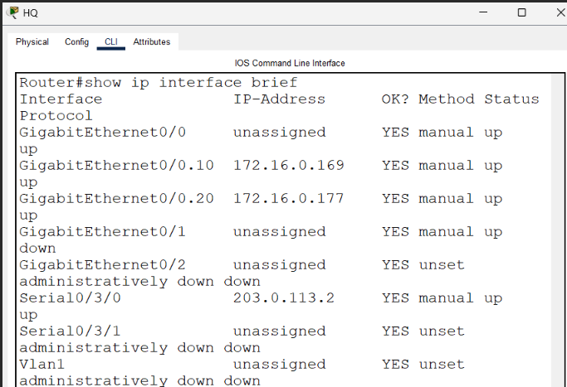
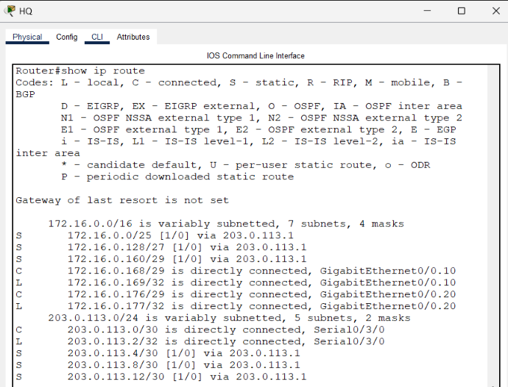
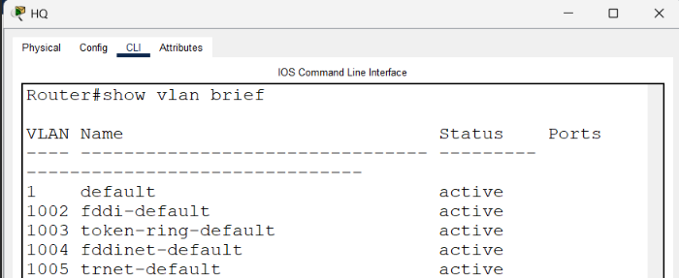
HQ : ROUTING, VLAN & ADDRESSING TABLE.

Slide 8
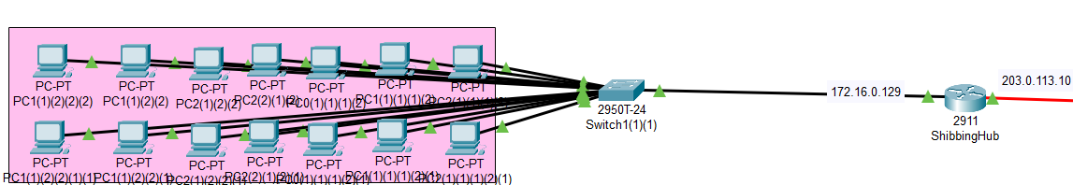
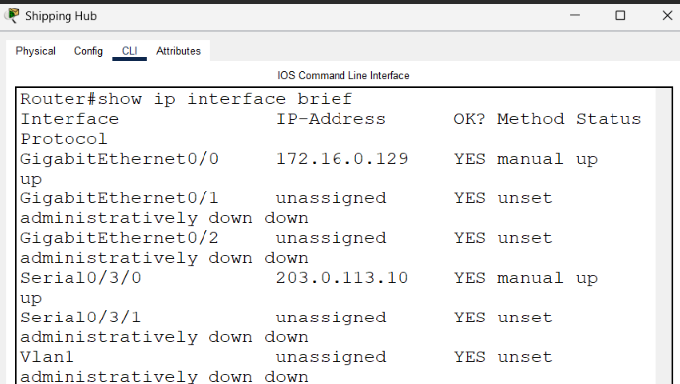
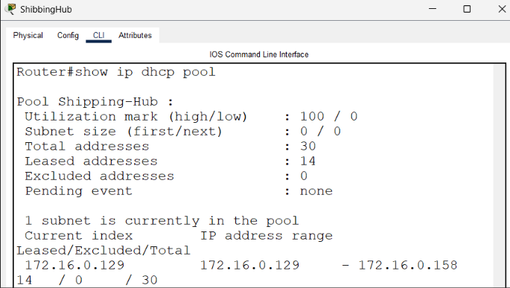
SHIBBINGHUP : DHCP& PING

Slide 9
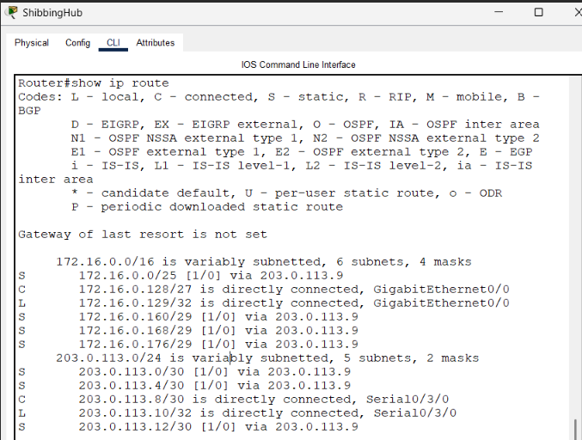
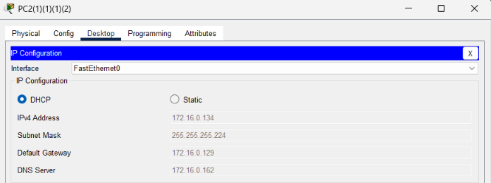
SHIBBINGHUP : ROUTING & ADD TABLE

Slide 10
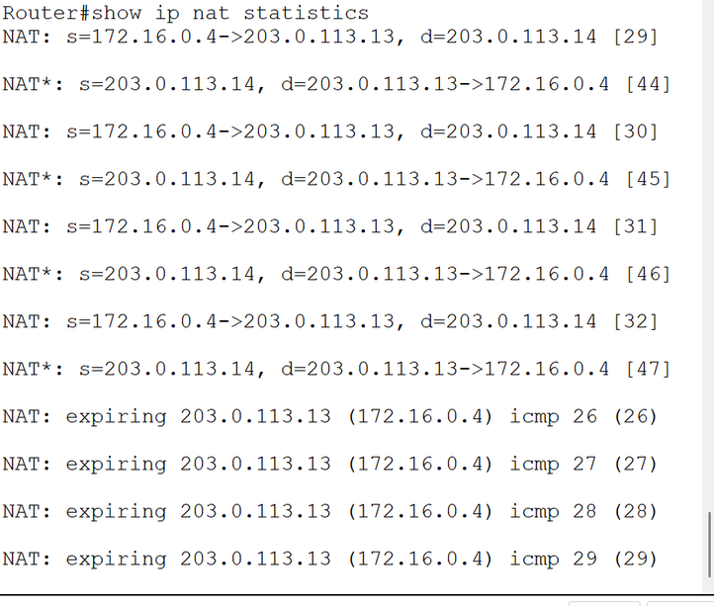
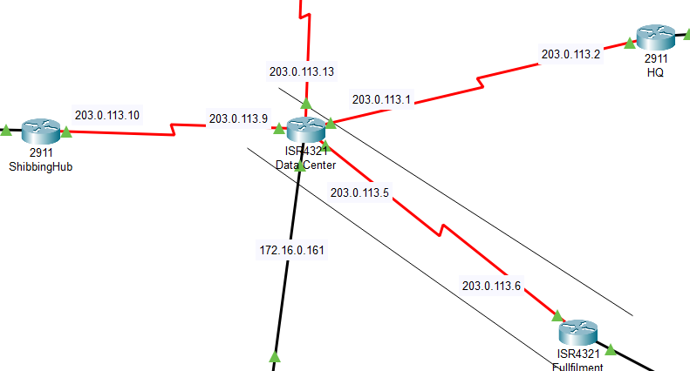
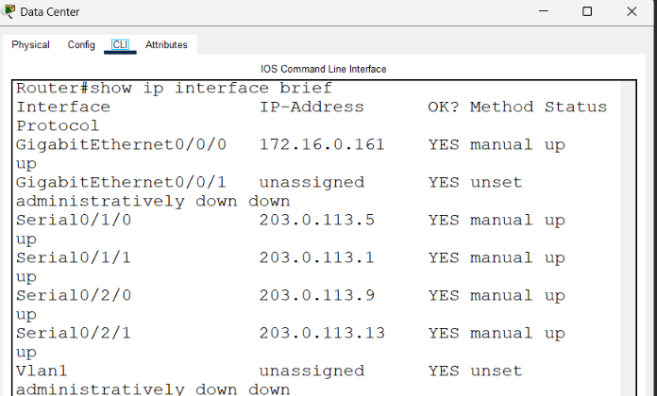
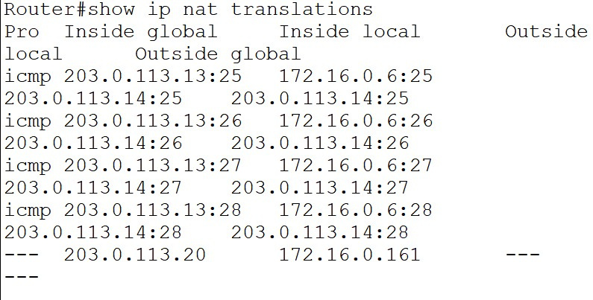
Data Center : NAT/PAT & Addressing Table

Slide 11
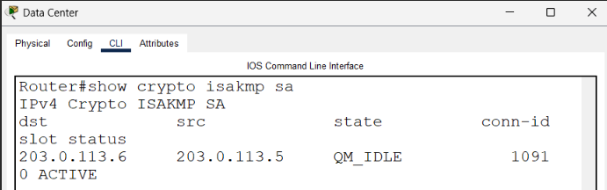
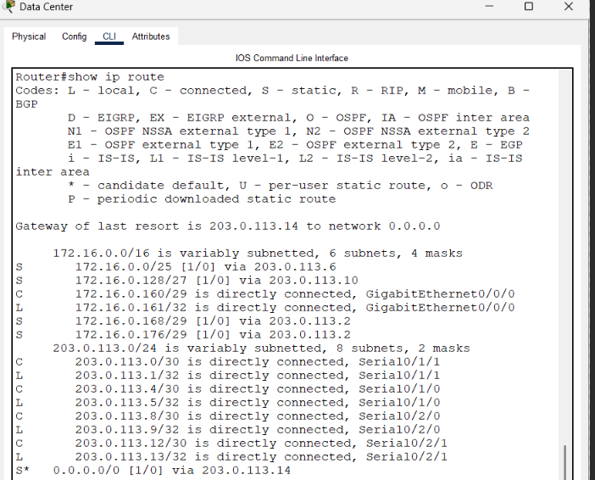
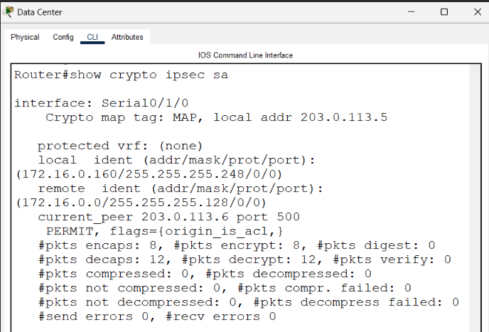
Data Center : VPN & Routing

Slide 12
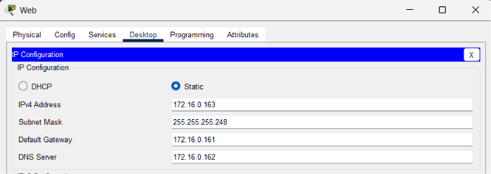
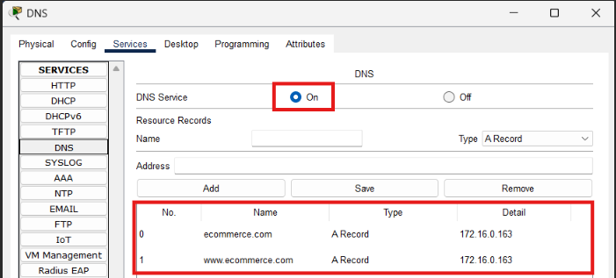
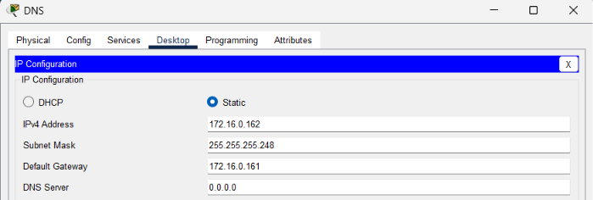
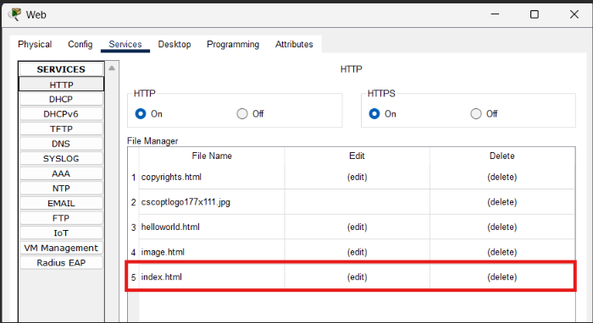
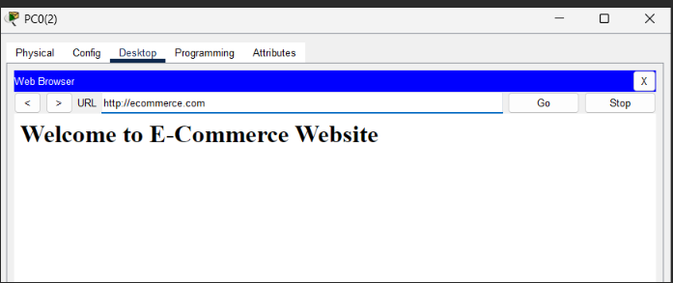
DATA CENTER : DNS & Web Servers

Slide 13
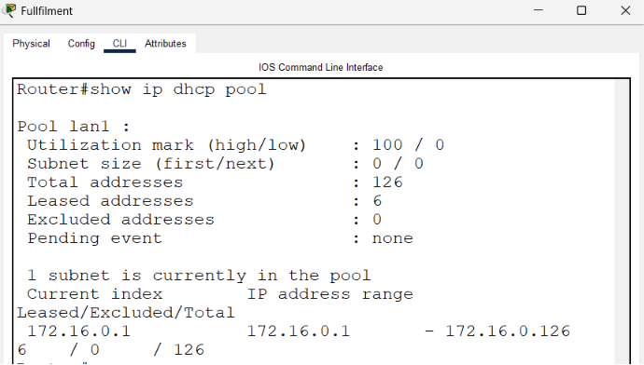
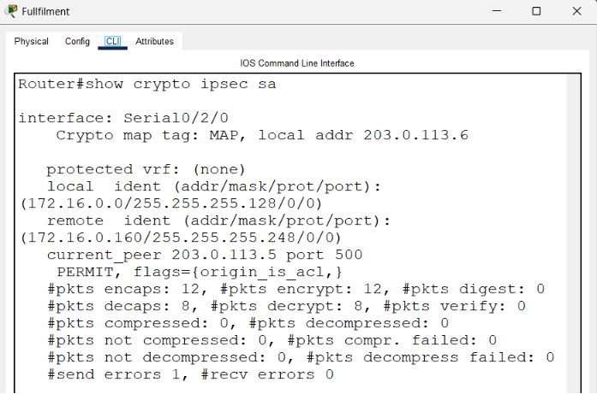
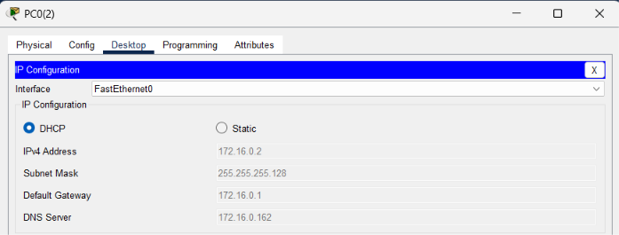
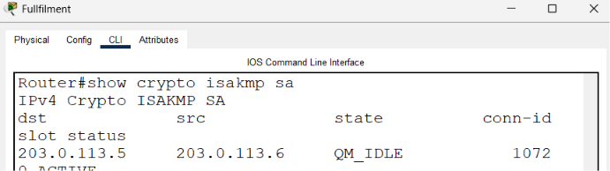
Fullfilment CENTER : VPN & DHCP

Slide 14
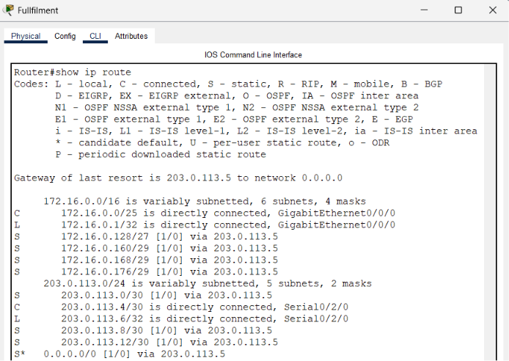
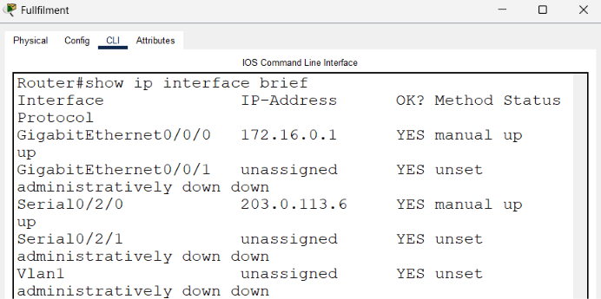
Fullfilment CENTER : Routing & Addressing Table

Slide 15
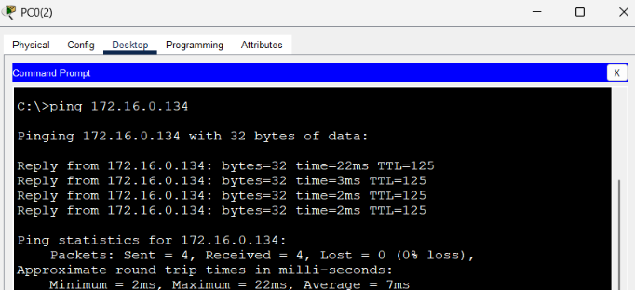
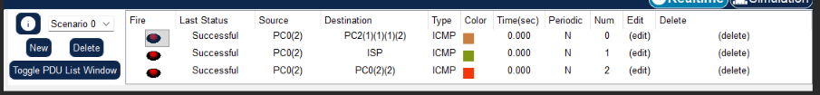
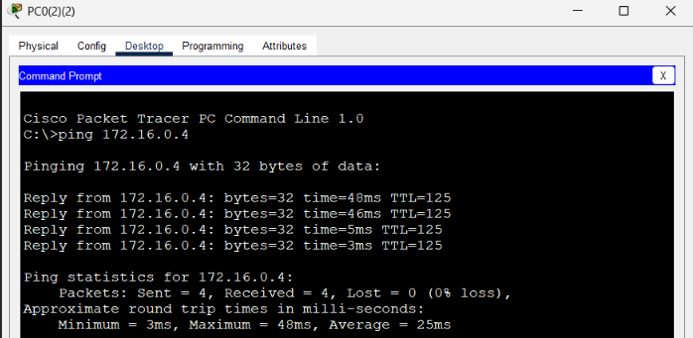
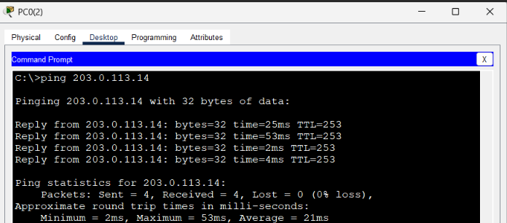
ICMP

Slide 16
Networks-1 Project
Thank You
Project 5

